Slide 1

Flip Story
How much changed?
Regional Shift
Where did it change?
DECODING THE 2026
TAMIL NADU
ASSEMBLY ELECTION
Research Focus
Electoral Margin
What stories deserve airtime?
How decisive was change?
Method
SQL
+
Power BI
Three Questions.
One Election.
Clear Insights.
ECI Data
AtliQ Show
2021-2026
By Narmatha Annadurai

Slide 2
Research Question Selection
From six research directions, three were selected to construct one connected election narrative.
Q2 | Flip Story
Analytical Purpose Track constituency-level winner realignment between 2021 and 2026.
Key Insight
Constituency Realignment
Why this Framework?
These questions examine the election through:
Scale
Distribution
Intensity
No predictions.
No explanations.
Only measured outcomes.
Q1 | Geographic Story
Analytical Purpose How did seat distribution shift across Tamil Nadu’s six regions between 2021 and 2026?
Key Insight
Regional Concentration
Q6 | Margin story
Analytical Purpose Evaluate how decisive electoral outcomes became across seats.
Key Insight
Electoral Decisiveness

Slide 3

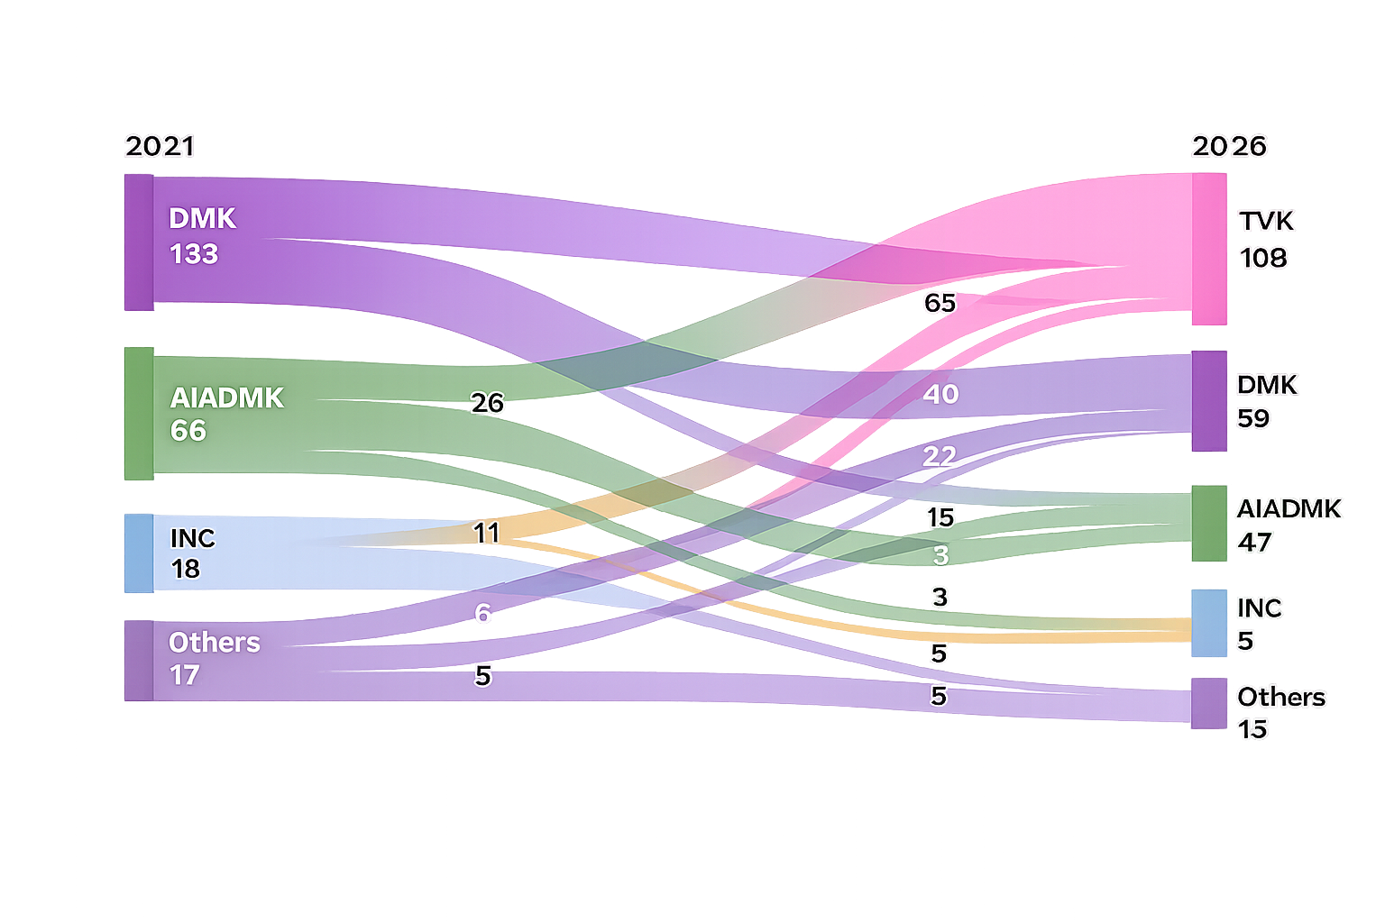
Flip Story
Story 01
Constituency
Realignment
163
71
234
Flipped Seats
69.66%
Retained Seats
30.34%
Total
Constituencies In tamil nadu
How extensively did electoral control shift?
Winner Movement : 2021 → 2026
Retained VS Flipped
Retained
71
(30.34%)
Flipped
163
(69.66%)
Tracking movement of winning formations between the 2021 and 2026 Assembly Elections across 234 constituencies.
234
total
234
163
71
Nearly seven out of ten constituencies recorded a change in winning formation.
Total
Constituencies
Flipped
Seats
Retained
Seats
Chennai Metro
93.8%
(30 / 32 constituencies flipped)
Largest Winner Flow
Most impacted region
Key Insight
DMK → TVK
65
Constituencies
Electoral movement was concentrated rather than evenly distributed across Tamil Nadu.
Flip Rate
69.66%
Source: ECI Results Portal (2026) / ECI Statistical Reports (2021) / Codebasics
2026 Election Results

Slide 4


Flip Story
Story 01 Findings
So What changed?
163
71
234
Flipped Seats
69.66%
Retained Seats
30.34%
Total
Constituencies In tamil nadu
Examining how electoral control shifted between 2021 and 2026.
Top Winner Transitions
Largest constituency movements between elections
Who Benefited Most?
What we Observed?
The 2026 election was not a minor reshuffle. 163 out of 234 constituencies changed winning formation. The movement was concentrated across selected formations rather than evenly distributed across all parties.
Nearly seven out of ten constituencies recorded a change in winning formation.
Largest Winner Flow
Retained Base
Key Insight
71
Constituencies
The result was not a uniform transition.
Most movement concentrated in a few high-volume party shifts.
DMK
TVK
65
Constituencies
retained their same winning formation
Source: ECI Results Portal (2026) / ECI Statistical Reports (2021) / Codebasics
2026 Election Results

Slide 5
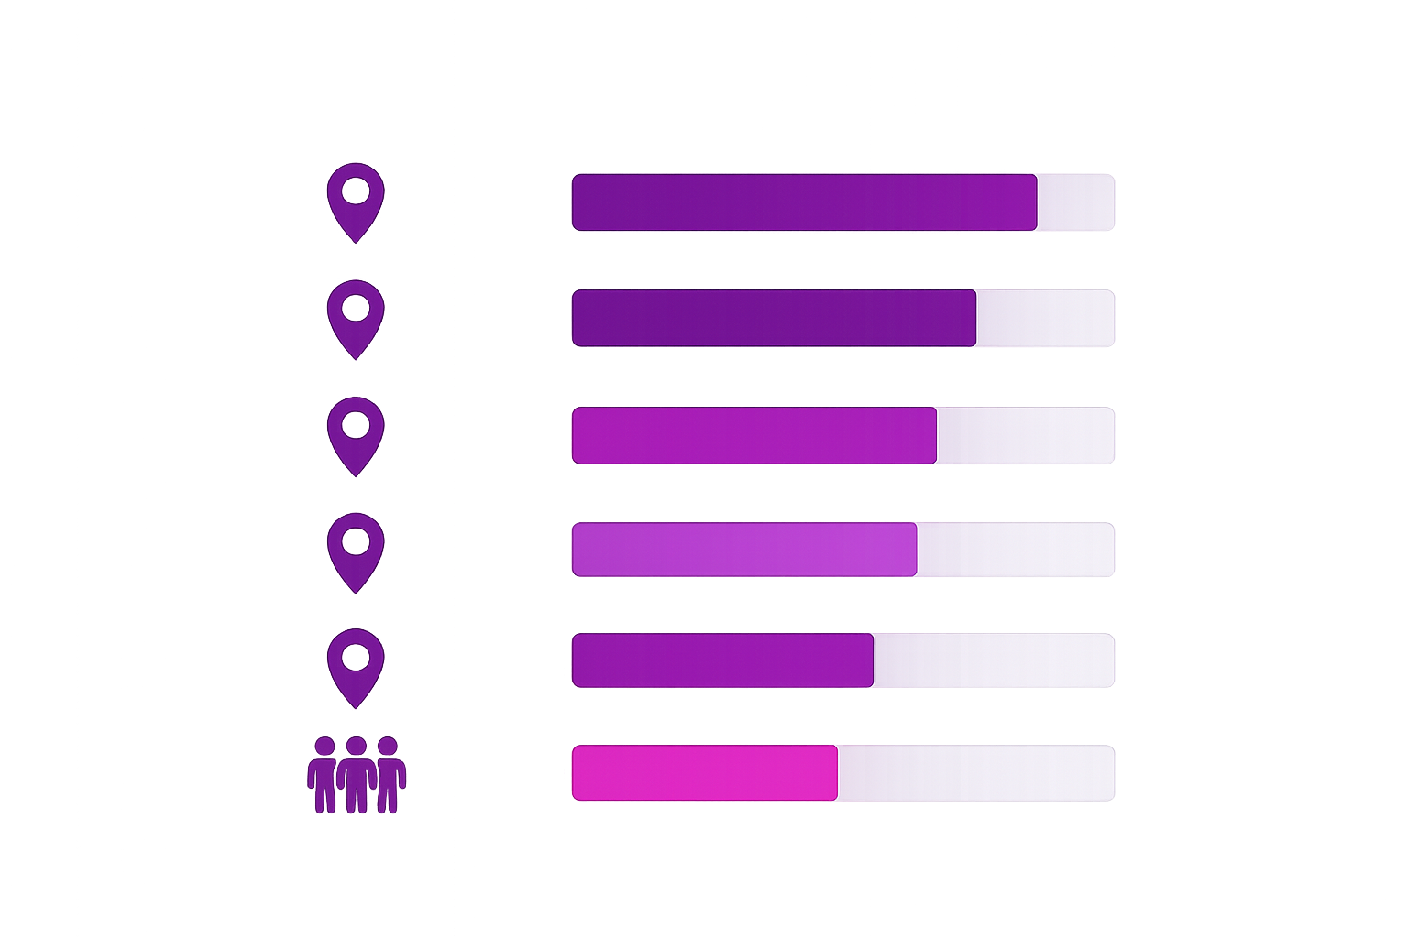
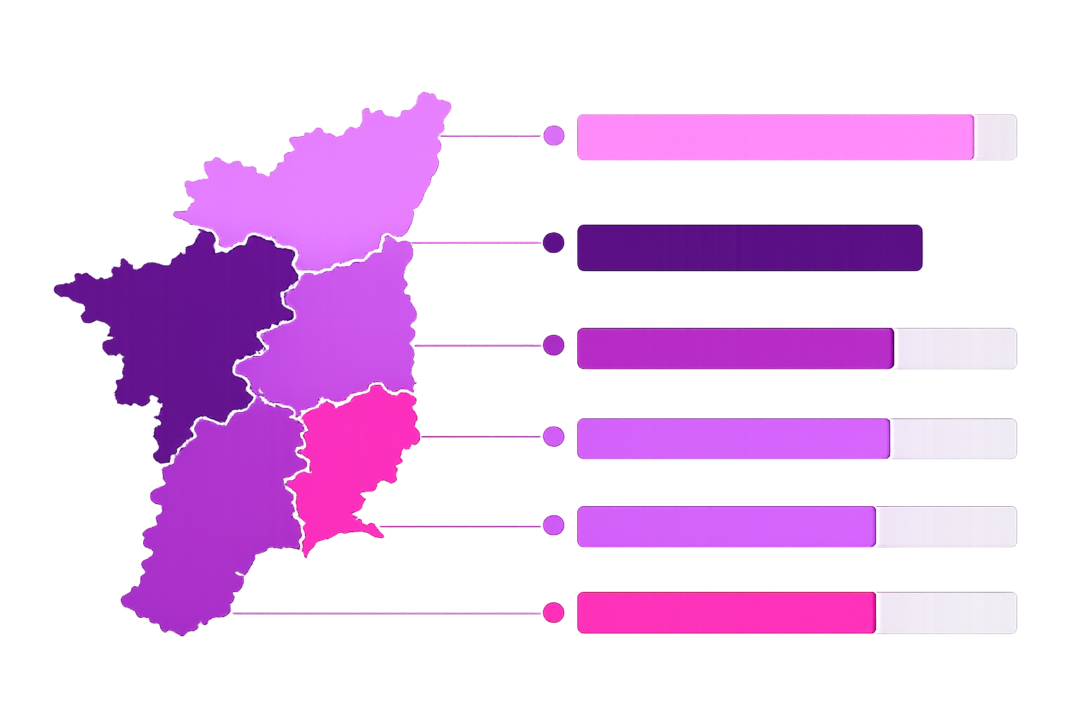
Geographic Story
Story 02
Geographic shift
163
71
234
Flipped Seats
69.66%
Retained Seats
30.34%
Total
Constituencies In tamil nadu
Where was electoral
change concentrated?
Regional Flip Intensity (2021 → 2026)
Share of constituencies that changed winning formation
Most volatile districts
(Share of constituencies flipped)
What we Observed?
Madurai
100.0%
(10/10)
Tiruvallur
100.0% (10/10)
Chennai Metro
Vellore
92.3%
(12/13)
Change was not uniform across the state. Western and Northern regions showed stronger movement.
TVK gained across regions.
93.8%
(30 / 32)
Kanchipuram
90.9%
(10/11)
West (Kongu)
Coimbatore
90.0%
(9/10)
81.8% (27 / 33)
These districts saw the most significant shifts in 2026.
North
73.0% (27 / 37)
South
65.5%
(38 / 58)
Net Movement by region
(Which party gained the most)
Central
63.4%
(26 / 41)
Central
Chennai Metro
Coastal (Delta)
West (Kongu)
North
South
Coastal (Delta)
TVK
TVK
TVK
45.5%
(15 / 33)
TVK
TVK
TVK
+12
+29
+10
+16
+15
+26
High Change (≥70%)
Moderate (60–69%)
Lower Change (<60%)
TVK is the net gainer in all regions
Key takeaway
What this means
Why it Matters
Electoral change was concentrated in specific regions.
Kongu (West) and North recorded the strongest shifts.
Coastal (Delta) remained relatively stable.
Regional dynamics played a critical role in shaping the2026 outcome.
Not every region moved in the same way.
Understanding regional patterns helps decode the drivers behind the statewide result.

Slide 6
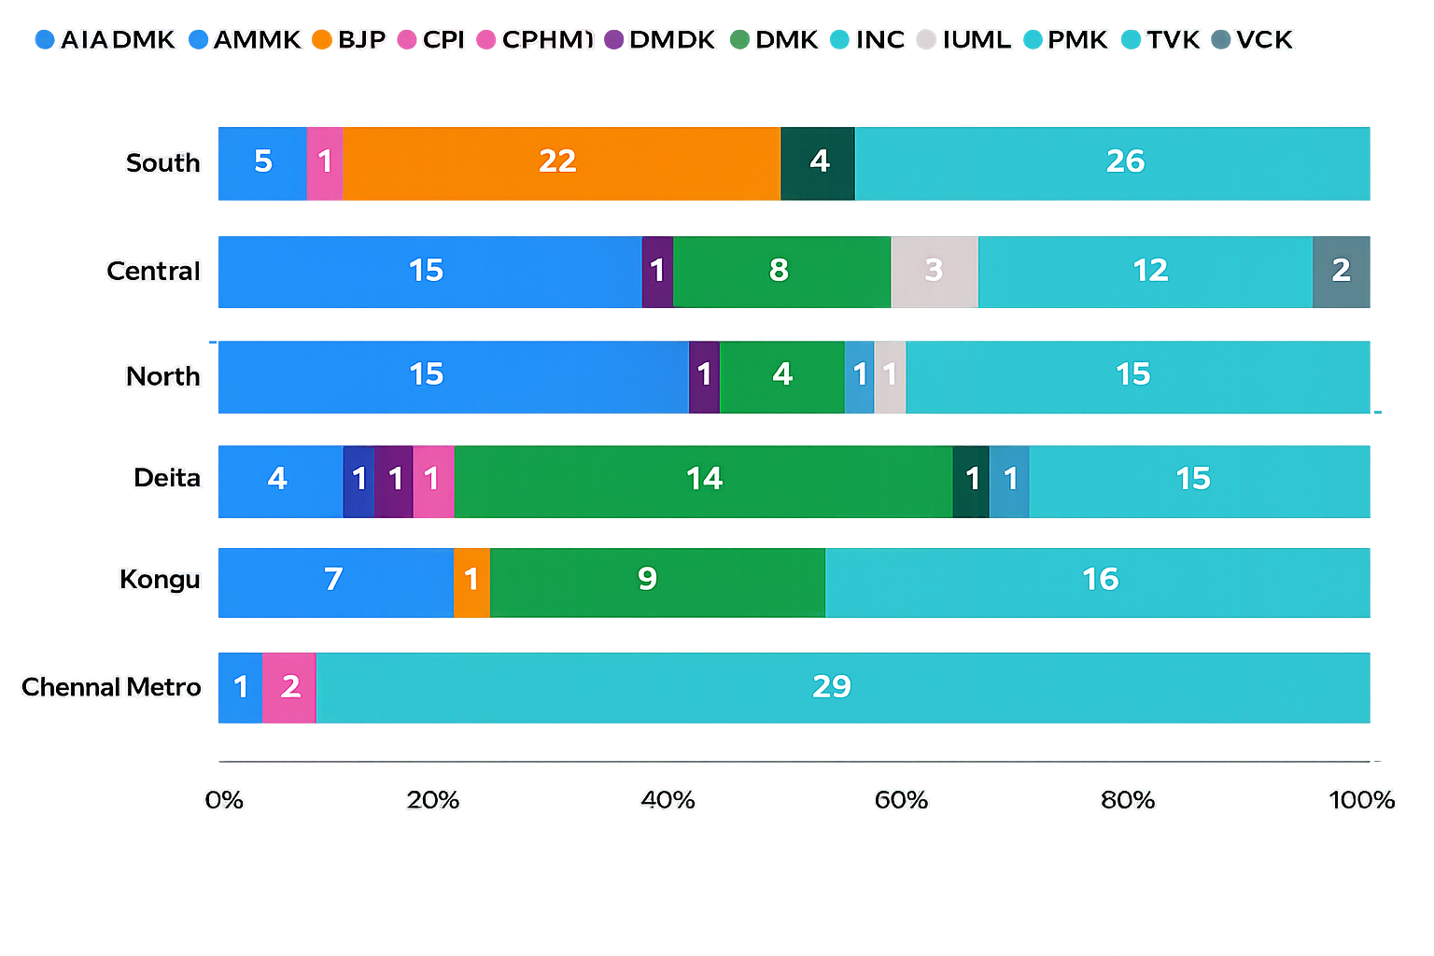
Geographic Story
6
3
234
Story 02 Findings
Regions Analysed
Regions Led By TVK
Total Seats Observed
Who Controlled the Regions?
Regional Party Dominance (2026)
Winning formation distribution by region
Leading Party By Region
AIADMK
15
Understanding which parties benefited across regions.
Central
Chennai Metro
29
TVK
What we Observed?
Delta
14
DMK
Kongu (West)
TVK emerged as the largest regional winner. Delta remained more resistant to change.
AIADMK retained strength in selected territories.
TVK
16
15
(Tie)
North
TVK/
AIADMK
South
26
TVK
Most Competitive Region
Lowest winner concentration
Region : North
Top share : 40.5%
Key takeaway
What this means
Why it Matters
TVK became the dominant
regional beneficiary,
but gains were not
uniform across Tamil Nadu.
Electoral concentration explains why statewide results alone can be misleading.
Regional dynamics reveal where political momentum actually shifted.

Slide 7
Margin Story
10
1
234
Story 03
The Battlefield of close Contests
Closest Constituencies
Lowest Margin(Votes)
Seats
Analysed
Exploring where elections were won by narrow margins.
Top 10 Closest Constituencies
Smallest victory margins in 2026
Who won the Close battles?
Rank | Constituency | Winner | Runner
1 | Tiruppattur | TVK | DMK
2 | Veppanahalli | DMK | AIADMK
3 | Kanniyakumari | AIADMK | DMK
4 | Polur | TVK | DMDK
5 | Tirukkoyilur | AIADMK | TVK
6 | Paramathi-Velur | AIADMK | DMK
7 | Kulithalai | DMK | TVK
8 | Kumbakonam | TVK | DMK
9 | Palani | AIADMK | TVK
10 | Tindivanam | VCK | AIADMK
Victory Margin
What we Observed?
Several constituencies recorded extremely narrow victory margins.
Total: 10
Close contests reveal where voter preference shifted most sharply.
Tightest Race
1
Vote
Margin pressure was not
distributed uniformly.
Key takeaway
What this means
Why it Matters
Close constituencies highlight where small vote swings altered electoral outcomes.
Winning margins help identify vulnerable political strongholds.
Small margins signal potential areas of future competition.

Slide 8
Margin Story
10
1
734
Story 03 Findings
What did the close battles reveal?
Closest Seats
Lowest Margin(Votes)
Largest Margin Among Top 10
Understanding what narrow victories tell us about electoral pressure.
Close contest winner profile
Distribution of winners across the top 10 closest constituencies
Most competitive seats
Top 4 seats with
the smallest victory margins
Pressure index
4 (40%)
What we Observed?
Tiruppattur 1 vote
3 (30%)
Close battles were distributed across multiple parties.
2 (20%)
Veppanahalli 138 votes
40%
of the closest seats were captured by AIADMK.
1 (10%)
Kanniyakumari 214 votes
Extremely small vote differences altered electoral outcomes.
Polur 227 votes
No single party completely dominated the closest contests.
Margins under 250 votes reflect intense competition.
Competitive seats may signal future battlegrounds.
Key takeaway
What this means
Why it Matters
Competitive constituencies can act as early indicators of future electoral change.
Small vote swings materially changed electoral outcomes.
Tracking close battles helps identify future competitive regions.

Slide 9
Connected Findings
What does the 2026 election tell us?
163
69.66%
1
Flipped Seats
Statewide Shift Rate
Closest Victory Margin
Out of 234 constituencies
Constituencies that changed
Among the top 10 closest seats
Bringing together the key stories from the 2026 Tamil Nadu election.
How the 2026 election story connects
Key Insight
Story 1
Story 2
Story 3
Together, these factors reshaped the political landscape beyond overall seat counts
Constituency
Realignment
Geographic
Shift
Close Battles
The Big Picture
163 constituencies changed winning formation.
Electoral movement was concentrated in specific regions.
Several seats were won through extremely narrow victory margins.
Key Takeaway
Large-scale constituency realignment reshaped the electoral landscape.
Winning elections is not only about total seats , it also matters where those seats were won and how closely.
TVK emerged as the largest beneficiary, gaining 65 seats from DMK.
Chennai Metro (93.8%)
and Kongu (81.8%)
recorded the
highest shifts.
Among the closest 10 seats, AIADMK
secured 4 wins.
Electoral movement was concentrated in specific regions and districts.
Future Outlook
Future elections may be influenced by the same high-movement regions and competitive pockets.
Several seats were won through extremely narrow victory margins.
Synthesis
Tamil Nadu's 2026 election combined constituency movement, regional concentration , and intense competition.
Movement was real and significant
Change was concentrated , not uniform
Margins revealed high competitiveness

Slide 10
Conclusion
Beyond the
numbers
163
69.66%
1
Seats Changed
State wide Shift
Smallest Winning Margin
Key reflections from the 2026 Tamil Nadu Electoral Analysis.
Final Editorial
Key Learnings
Election outcomes are shaped not only by seat totals but by where those seats shift.
The 2026 Tamil Nadu election was not defined by a uniform wave across the state.
Constituency movement explains who gained.
Regional concentration revealed patterns that state wide summaries cannot fully explain.
Instead, change occurred through concentrated regional movement and competitive constituencies.
Regional analysis explains where change occurred.
Understanding these local patterns provides deeper insight than statewide seat counts alone.
Margin analysis explains how stable those outcomes are.
Close contests highlighted constituencies that may shape future elections.
What this means
Editorial Recommendation
Data Limitations
Focus future election analysis on regions with high seat movement and constituencies with narrow victory margins.
Regional concentration and competitive seats provide stronger signals than state wide totals alone.
Regional and constituency analysis provides deeper insight than state wide seat totals alone.
This analysis focuses on seat movement and election outcomes.
Turnout drivers , demographic effects ,and candidate-level factors were not included.

